Slide 1
God’s Shaping of His Story
Isaiah 45

Slide 3
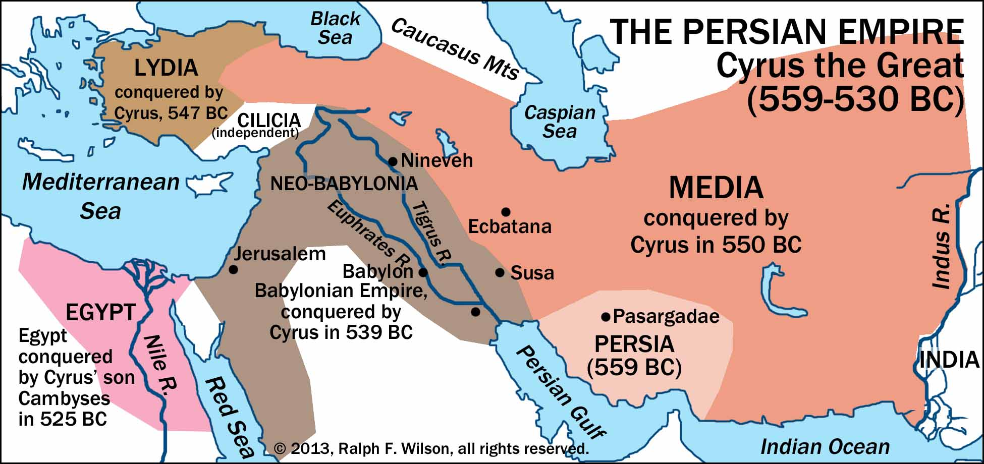

Slide 4
Anointed
לִמְשִׁיחוֹ֮ lim·šî·ḥōw (to his anointed)
The term “anointed” is the Hebrew term for “Messiah.”
This exact form occurs 2 other places: 2 Sam. 22:52 and Psalm 18:50. Both of those refer to David.
Anointed can also imply a king or ruler or priest to deliver someone.
God led the way for Cyrus to become Persia’s King. God elevated him to that place. God took Cyrus by the hand and showed him the mission that awaited him. God called Cyrus the anointed.
Cyrus credited the Babylonian god Marduk (as written on the Cyrus Cylinder) for his success.

